Slide 1
Welcome! Advanced Java
Introduction

Slide 2
Course Objectives
After successfully completing this course, you will be able to:
Develop object-oriented applications in Java using best coding practices
Implement classes with fields, constructors, and methods
Leverage interfaces for extensibility
Work with collections of objects
Throw and handle exceptions correctly
Employ Java best practices to create maintainable programs

Slide 4
Let's Talk About
In this chapter, we will learn:
Design Patterns
Architectural Patterns

Slide 5

Good Code Design
Design Patterns
Architectural Patterns
Exercise

Slide 6
OO Revisited
What do each of these terms mean?
Encapsulation
Coupling
Composition
Aggregation
Inheritance
Delegation
Abstract Class
Interface

Slide 7
SOLID Principles Revisited
What do each of the SOLID Principles mean?
Single Responsibility Principle
Open Close Principle
Liskov Substitution Principle
Interface Segregation Principle
Dependency Inversion Principle

Slide 8
Design Patterns
Design Patterns: Elements of Reusable Object-Oriented Software
By Erich Gamma, Richard Helm, Ralph Johnson and John Vlissides aka “Gang of Four Book” (GoF) (Addison Wesley; 1994)
The book identified 23 patterns
Some of which were required to implement a case study for a WYSIWYG editor
Called the GoF patterns
Code examples in C++ and Smalltalk
They are solutions to often encountered business problems

Slide 9
More Design Patterns
More design patterns have been defined since GoF
Anyone can define a new pattern
They must have a good name
This is how they are identified
They must be realized in at least 3 systems
They must be applicable to new contexts
Patterns have been defined for newer technologies
Web applications
Enterprise JavaBeans
Architecture patterns
Can you name some design patterns?

Slide 10
Using Design Patterns
Design patterns should only be used where there is a definite need
They by definition increase code complexity and they are often used inappropriately
Never use a design pattern just because you know it
Design patterns are language agnostic
They are often defined in UML
Implementation code is often complex and confusing
Some are not necessary in some languages and necessary in others
The Iterator pattern is part of the Java collections API
There are plenty of code examples online

Slide 11
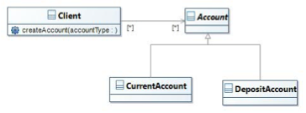
A Problem?
Clients need to create objects of different flavors
What is wrong with this model from the client perspective?
Are any of the SOLID principles violated?

Slide 12
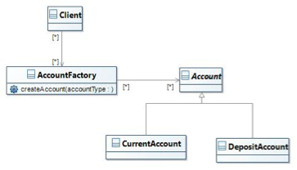
Factory
Delegate the responsibility for creation to a factory object
Is this a better approach? If so why?

Slide 13
Factory Discussion
The factory is a very common pattern
Many APIs and frameworks use it
When is a factory a good solution?

Slide 14
A Problem?
Need to store objects in a tree structure
Nodes and branches need to be treated in a similar way
A file system has directory nodes which are a type of file
XML elements can be leaf nodes or contain other elements

Slide 15
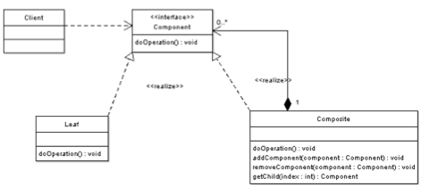
Composite
A composite has leaves and branches implement the same interface

Slide 16
Composite Discussion
When is a composite a good solution?

Slide 17
A Problem?
Need to deal with the absence of an object
Null references are problematic—why?
Which SOLID principles are involved?
Some modern languages do not support null values

Slide 18
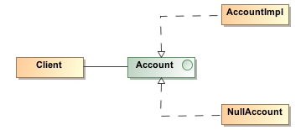
Null Object
Provide an implementation of an interface which does nothing
Provide a static instance of a class which does nothing
Is this a useful pattern?

Slide 19
A Problem?
Objects need to be informed when other objects change state
An object may need to inform several objects that its state has changed
Which SOLID principles are involved?

Slide 20
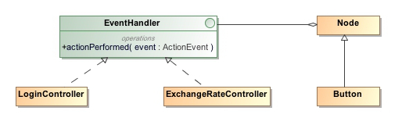
Observer
Observer defines a one to many relationship between objects
Often used in graphical user interfaces
Subject maintains a list of observers
It notifies all observers when the state changes
Where would you use this?

Slide 21
A Problem?
Several classes only differ in their behavior
Need to select an algorithm at run time
Large switch and if statement are considered code smells
Which SOLID principles are involved?

Slide 22
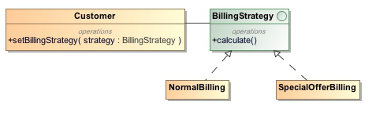
Strategy
Each strategy implements a different algorithm
It has a context object which delegates to a strategy
New strategies can be added without changing the context object
The required strategy injected using dependency injection
Where would you use this?

Slide 23
Good Code Design
Design Patterns
Architectural Patterns
Exercise

Slide 24
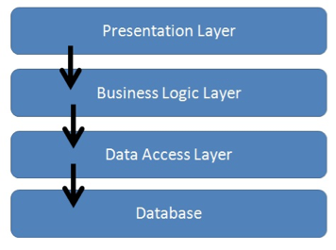
N-Tier Architecture
Divide applications into Presentation, Business, and Integration tiers
Control always in one direction to avoid cyclic dependencies
Often 3 tiers but can have more

Slide 25
N-Tier Discussion
Is N-Tier a good thing and when should it be used?
Where do stored procedures fit into this?
This topic can start major battles!

Slide 26
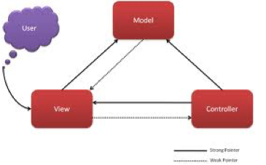
Model View Controller (MVC)
A pattern residing in the presentation tier
It decouples user interface components
There are variants on the theme
Let’s look at the components in turn

Slide 27
Model View Controller
The model represents the business data required to build the view
It can be tested in isolation
It is required to create and update the view
It is updated by the controller

Slide 28
Model View Controller
The view represents the display and user interaction
It is difficult to test in isolation—it is often kept very thin
It renders the model—it sometimes needs its own version of the model
It is created or updated by the controller

Slide 29
Model View Controller
The controller processes user interaction events and other updates
It can be tested in isolation—may require HTTP emulation
It updates the model
It creates or updates the view
The controller is often built using a framework—Struts, Spring MVC

Slide 30
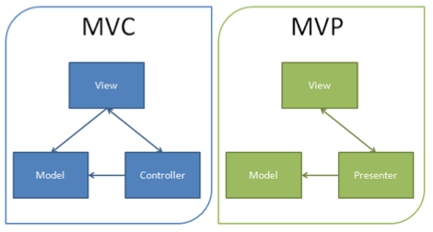
Model View Presenter (MVP)
The model view presenter completely decouples the model from the view
The presenter is decoupled from the view using an interface—allows the view to be mocked for test purposes

Slide 31
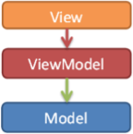
Model View ViewModel (MVVM)
MVVM is an MVC variant used by Microsoft
It is also used by AngularJS
The ViewModel is
An interface between model and view
Provides data binding between view and model data
It is also easier to test
Handles all UI actions

Slide 32
MVC Discussion
What are the issues associated with MVC and its variants?

Slide 33
Good Code Design
Design Patterns
Architectural Patterns
Exercise

Slide 34
Exercise
Please refer to Exercise 1: Design Patterns

Slide 35
To Sum Up
In this chapter, we have learned:
Design Patterns
Architectural Patterns

Slide 36
Design patterns
Design Patterns

Slide 37
Chapter Concepts
Template Method
Strategy
Factory
Composite
Façade
Adapter

Slide 38
Design Patterns
Template Method
Strategy
Factory
Composite
API Design

Slide 39
Duplicated Code
The Louvre gets a lot more visitors than the Art Gallery of Ontario
So the numbers are different, but logic is similar
How can this code be improved?
public class MVCSLouvreImpl extends AbstractMaxVisitorCountService {
public int getMaxVisitorCount(Exhibit e){
if ( e.getNumAnnualVisitors() > 1000*1000 ){ // > 1 million
return e.getNumAnnualVisitors() / (24*365); // hourly no.
} else {
return securityHelper.estimate(e);
}
}
}
public class MVCSOntarioImpl extends AbstractMaxVisitorCountService {
public int getMaxVisitorCount(Exhibit e){
if ( e.getNumAnnualVisitors() > 10000 ){ // > 10,000
return e.getNumAnnualVisitors() / 365; // daily no
} else {
return securityHelper.estimate(e);
}
}
}

Slide 40
Template Method Design Pattern
The Template Method Design Pattern allows for the reuse of code structure
Not just code
public abstract class MVCSPopularitySecurityTradeoffImpl extends AbstractMaxV… {
public int getMaxVisitorCount(Exhibit e){
if ( e.getNumAnnualVisitors() > getPopularityThresh() ){
return getVisitorCountForPopularExhibits(e);
} else {
return securityHelper.estimate(e);
}
}
protected abstract int getPopularityThresh();
protected abstract int getVisitorCountForPopularExhibits(Exhibit e);
}
Method structure set by superclass
(“template”)
Subclasses customize template
public class MVCSLouvreImpl extends MVCSPopularitySecurityTradeoffImpl {
protected int getPopularityThresh(){ return 1000*1000; }
protected int getVisitorCountForPopularExhibits(Exhibit e){
e.getNumAnnualVisitors() / (24*365); // hourly no.
}
}

Slide 41
When To Use Template Method
The Template Method design pattern leads to deep inheritance hierarchies
Deep hierarchies are rigid and hard to maintain
Better to have common code in helper classes
“Off the hierarchy”
Use Template Method only if you already have an inheritance hierarchy
Move common code up the hierarchy
Taking care to move the calling structure also up the hierarchy
Allow subclasses to customize the method
Do not create an inheritance hierarchy just to use Template Method
Use the Strategy design pattern instead

Slide 42
Exercise: Template Method
10 min
Open Eclipse and switch to the workspace roijava\java2\projects
File | New Project | Project from Ant build file
Browse to and select pattern_exercises/build.xml
Click Finish
In the ‘patterns_exercises’ project, examine the templatemethod package
There are two types of Exhibits: Permanent and OnLoan
Implement the Template Method pattern so that ExhibitTest works

Slide 43
Design Patterns
Template Method
Strategy
Factory
Composite
API Design

Slide 44
Strategy Design Pattern
The Template Method Design Pattern leads to deep hierarchies
Better to factor out customization to external helper classes
Single, concrete class for both Louvre and Ontario
public class MVCSPopularitySecurityTradeoffImpl extends AbstractMaxV… {
public int getMaxVisitorCount(Exhibit e){
if ( e.getNumAnnualVisitors() > options.getPopularityThresh() ){
return options.getVisitorCountForPopularExhibits(e);
} else {
return securityHelper.estimate(e);
}
}
private PopularityOptions options;
public MVCSPopularitySecurityTradeoffImpl(PopularityOptions o){
this.options = o;
}
}
Specify strategy object on construction

Slide 45
Strategy Design Pattern (continued)
Can now create separate PopularityOptions (“strategies”)
The original service is customized at runtime using the strategy object
Using constructor, setter method or as parameter to method
public class LouvrePopularityImpl implements PopularityOptions {
public int getPopularityThresh(){ return 1000*1000; }
public int getVisitorCountForPopularExhibits(Exhibit e){
e.getNumAnnualVisitors() / (24*365); // hourly no.
}
}
MaxVisitorCountService mvcs = new MVCSPopularitySecurityTradeoffImpl(
new LouvrePopularityImpl() );
Exhibit e = …;
mvcs.getMaxVisitorCount( e );

Slide 46
Exercise: Strategy
10 min
In the ‘patterns_exercises’ project, open ‘strategy’ package
Automatic Gate at museum needs to validate Ticket before it opens
Some gates validate based on only ticket expiry time
Other gates will need to check whether the ticket is valid only for permanent exhibits
For now, ignore ticket expiry time in such a case
Use Strategy design pattern to implement this
GateTest should pass
You need to uncomment the Gate constructors in the unit test

Slide 47
Template Method vs. Strategy
The Strategy design patterns allows for code reuse
Customizations are done in separate helper classes
The Template Method design pattern also allows for code reuse
Customizations are done in separate subclasses
The Template Method is not as flexible as Strategy
Prefer Strategy to Template Method unless hierarchy already exists
Why is the strategy more flexible?
Template Method
Strategy

Slide 48
Delegation Is More Flexible Than Inheritance
Suppose we really do have type of Gates: Turnstile and Door
This is how to fit this into the Strategy and into the Template Method:
Template Method
Strategy

Slide 49
Design Patterns
Template Method
Strategy
Factory
Composite
API Design

Slide 50
Creating Objects on Demand
Often need to be able to create objects interactively
Say there’s an application that lets a curator configure an exhibit
What’s the drawback of directly invoking constructors like this?
String exhibitName = …; // from user selection
String exhibitType = …; // from user selection
Exhibit newExhibit;
if (exhibitType.equals("permanent")){
newExhibit = new PermanentExhibit(exhibitName);
} else if (exhibitType.equals("visiting")){
newExhibit = VisitingExhibit(exhibitName);
} else {
throw new IllegalArgumentException(…);
}
// newExhibit can now be used
Notes:
Does not scale

Slide 51
Limitations of Directly Invoking Constructor
Ideally, such creation code is centralized in a factory
So, this is not a problem of duplicate code lying around
Directly invoking constructor is not flexible
If new type of Exhibit is added, the code has to be modified
The if-then statements do not scale
Maintainability problem once we have more than 4-5 subclasses

Slide 52

Constructors and Overridden Methods
Suppose AbstractExhibit invokes a method in its constructor:
And PermanentExhibit over-rides the validateName() method
With stricter rules than valid for all exhibits
Which method gets called? Will it work correctly?
Try running com.javamuseum.incompleteconstruction.Sub in patterns_checkitout as a Java application. What does this say about calling overrideable methods from constructors?
public class AbstractExhibit implements Exhibit {
public AbstractExhibit(String name){
validateName(name);
}
public void validateName(String name){ … }
}
10 min
Notes:
The subclass method gets called. However, the subclass’ fields have not been initialized yet.
This can cause problems.

Slide 53
Reflection to Rescue
Java reflection can be used to avoid directly invoking constructor
First provide a source of application configuration
Could be XML configuration file, a properties file, database, …
The configuration file maps “exhibitType” (user selection) to class name
Then, use Class.forName() to load the class
And instantiate a new instance:
permanent=com.javamuseum.business.PermanentExhibit
visiting=com.javamuseum.business.VisitingExhibit
String exhibitType = …; // from user selection
String className = properties.get(exhibitType); // lookup
Class cl = Class.forName(className);
Exhibit newExhibit = (Exhibit) cl.newInstance();
// newExhibit can now be used

Slide 54
Construction Parameter
Suppose PermanentExhibit needs an exhibitName
One option is to provide the name by invoking a setter in the factory:
The other option is to use reflection to invoke appropriate constructor:
public Exhibit newExhibit(String exhibitType,String exhibitName){
String className = properties.get(exhibitType); // lookup
Class cl = Class.forName(className);
Exhibit newExhibit = (Exhibit) cl.newInstance();
newExhibit.setName(exhibitName);
}
public Exhibit newExhibit(String exhibitType,String exhibitName){
String className = properties.get(exhibitType); // lookup
Class cl = Class.forName(className);
Constructor cs = cl.getConstructor(new Class[]{String.class});
return (Exhibit) cs.newInstance(new Object[]{exhibitName});
}

Slide 55
Location of Configuration File
Avoid hard-coded paths for location of configuration file
Better to look in classpath of application
InputStream is = ExhibitFactory.class.getClassLoader()
.getResourceAsStream(
"com/javamuseum/business/exhibitfactory.properties");

Slide 56
Overridden Methods
A method like validateName() can be moved out of superclass constructor
The invocation can be done in factory:
Now validateName() can be over-ridden
No problem now with subclass method being called on incompletely constructed object
public Exhibit newExhibit(String exhibitType,String exhibitName){
String className = properties.get(exhibitType); // lookup
Class cl = Class.forName(className);
Constructor cs = cl.getConstructor(new Class[]{String.class});
Exhibit e = cs.newInstance(new Object[]{exhibitName});
e.validateName(); // polymorphic method behaves correctly
return e;
}

Slide 57
Benefits of a Factory
Advantages of a factory:
Centralize creation code
Invoke polymorphic initialization methods
Constructors in Java can not be over-ridden, but an init() method can
Make it easy to add new subclasses to system
How do you add a new subclass to application?
Write new subclass
Add class name to configuration file
Put subclass in classpath of application
Class.forName() only looks in the classpath of the application
Will not load from external locations
To load from an external location, need to use a custom class loader

Slide 58
Exercise: Factory
20 min
Open the ‘patterns_exercises’ project and examine the ‘factory’ package
Implement the factory
Write the configuration file
Uncomment code in unit test
Make sure that unit test passes

Slide 59
Design Patterns
Template Method
Strategy
Factory
Composite
API Design

Slide 60
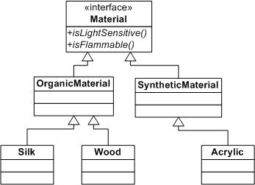
Need for Mixtures
Consider the Material hierarchy:
Most items are a combination of different types of materials:
For example, could have acrylic on wood
How would you represent this?

Slide 61
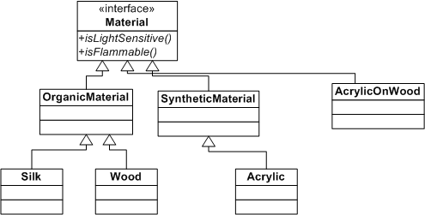
Anti-Pattern
The anti-pattern solution is to create a custom class for each combo:
Naturally, this does not scale well
What is the solution?

Slide 62
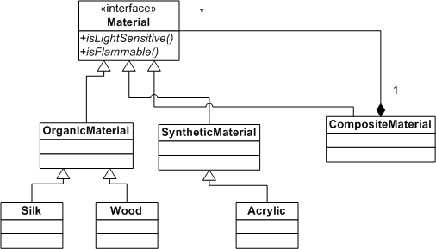
Composite Design Pattern
Allow client code to create the combination at runtime
Just provide a general-purpose composite class

Slide 63
Implementation of Composite
The Composite has both is-a and has-a relationship with base class
Methods typically iterate through all the components and call underlying method
public class CompositeMaterial implements Material {
private List<Material> pieces = new ArrayList<Material>();
public void addMaterial(Material m){ pieces.add(m); }
public boolean isLightSensitive(){
// is any piece light-sensitive?
for (Material m : pieces){
if (m.isLightSensitive()){
return true;
}
}
return false;
}
// etc.
}

Slide 64
Creation of Composite
The actual composite desired is created by client code on demand:
This could easily be done through general-purpose code
Perhaps a constructor to create object from String specification
From configuration file or user input
CompositeMaterial acrylicOnWood = new CompositeMaterial();
acrylicOnWood.addMaterial( new Acrylic(…) );
acrylicOnWood.addMaterial( new Wood(…) );
Material acrylicOnWood = new CompositeMaterial("acrylic+wood");

Slide 65
Composite and Recursion
Since CompositeMaterial is a Material, can do this:
Now, isLightSensitive() on the collage would call isLightSensitive() on acrylicOnWood which would call isLightSensitive() on acrylic
Methods are called recursively
Way to implement recursion in an object-oriented manner
Recursive method calls are a natural byproduct of tree structure
Methods end up walking tree until a leaf node is encountered
Material acrylicOnWood = new CompositeMaterial("acrylic+wood");
CompositeMaterial collage = new CompositeMaterial();
collage.add( acrylicOnWood );
collage.add( new Silk(…) );

Slide 66
Exercise: Composite
15 min
Open the ‘composite’ package of ‘patterns_exercises’ project
Examine the classes
There are two Command classes (AddItem and RemoveItem)
Would like to be able to create macro commands
“Call Add Item twice”
How would you do it?
Implement the Composite pattern
Complete the unit test code
Run the unit test and make sure it passes

Slide 67
Design Patterns
Template Method
Strategy
Factory
Composite
API Design

Slide 68
What Is an API?
What is an application programming interface (API)?
It’s the way that programmers access/utilize a useful framework
It is not the framework itself!
An API can consist of:
Classes, interfaces, methods, fields
Configuration files, environment variables, command-line parameters
Network and communication protocols
Error and status messages
We’ll focus on the Java part; ideally, the rest are standards or irrelevant

Slide 69
Simplicity
Aim for simplicity and ease-of-use in the API
The bigger the API, the steeper the learning curve
Add to the API only features needed by client code
Break up modules if necessary
API should do one thing and do it well
Leave out unnecessary parameters
Makes API hard to understand, harder to change
Definitely no tuning parameters
Hardware, performance characteristics of underlying systems change
API should be independent of implementation details
Avoid tendency for APIs to reflect the implementation closely
For important APIs, may be useful to create two implementations
Just to make sure no unwanted details have leaked out into API

Slide 70
Packages and Visibility
Use a core package
Put factories, interfaces and data types (POJOs) in the core package
This is the “public” view of your framework; i.e., the API
Use private implementation packages
Place for all the code that users of your framework don’t need
Users can ignore these classes when learning to use API
Can force users to never be able to use these classes
Make sensitive methods take a parameter of Class X
Ensure that class X has only a package-friendly constructor
Then, methods can be called only within package
Notes:
You may get a question: but what about the core package? How will it call these classes?
Answer: it won’t. The core package consists of interfaces which are implemented by the private impl. package.

Slide 71
Backward Compatibility
API should remain backwards-compatible as much as possible
Don’t remove methods, interfaces or classes from API
When adding new features, consider overloading methods or adding new subclasses and subinterfaces
Do not add methods to an existing interface (Why?)
If making a completely clean break, use different package names
One way to make programs future-proof is to make parameters to methods be interfaces rather than concrete objects
Only what is needed by system and nothing more
Notes:
Otherwise, client code that implements the interface will no longer work

Slide 72
Naming Consistency
Make sure that Java naming conventions are followed
Many Java APIs flout this by having methods like size()
What should it have been?
Do not abbreviate method names
Most users use IDEs which will do method completion
Code is written once, read many, many times
Be careful of parameter order within API
When asking for two parameters, always ask for them in same order
Document all aspects of the API
JUnit: asssertEquals( boolean expected, boolean actual );
Notes:
Java.util.List should have had getSize()

Slide 73
Reporting Errors
Prefer compile-time errors to runtime errors
Use the most specific parameter type
Use generics and type-safe enums
When providing runtime errors, make sure to report the error at the point the mistake was made
An egregious example of this is the Properties class again
The put method is defined as put(Object key, Object value)
Works if you pass in a non-String
The save() method throws a ClassCastException long after the problem code

Slide 74
Façade Design Pattern
The Façade design pattern is a formal way of achieving ease-of-use in API
Client code interacts only with the Façade class
The Façade interacts with other classes of framework
Can make backward compatibility easier to maintain
The Façade presents a simple, comprehensible view of framework
In a networked system, can also offer performance benefits
Fewer calls over network between client and server

Slide 75
What Is the Façade?
The Façade can be a single class
With methods corresponding to various use cases
The methods may all be stateless (common in web services)
Or the methods may store client’s state between invocations
Different clients will use different façade instances (common in web apps)
public class TicketingFacade {
Ticket purchaseTicket(TicketType t, int numTickets,
Exhibit[] extraExhibits){…}
void cancelTicket(Ticket t){…}
}
public class TicketingFacade {
void chooseTicketType(TicketType t){…}
void setTicketQuantity(int q
){…}
void buyTicket(){…}
}

Slide 76
Façade or Not?
The façade is any extra layer introduced to simplify client code
Arguably, factories and interfaces form a façade too
ExhibitDesignService e = ExhibitDesignServiceFactory.newService();

Slide 77
Reusing Third Party or Legacy Code
Often existing code offers most desired functionality
But is not part of current system architecture
How should the two existing systems be modified so that they can interact?
Want this
Have this code
Medium and artist are part of a painting’s fields. Provenance is not, but is available in a database and can be looked up if needed..
Notes:
Next slide: use adapter

Slide 78
Adapter Design Pattern
The Adapter Design Pattern recommends:
Implement the interface you want
In terms of the code you have
Do not modify the “legacy” code in any way
The rest of your system can act as if this were a natively available capability
PaintingValuationService could look up provenance from a database or supply bogus provenance
Rest of your code should not need to suddenly keep track of provenance

Slide 79
Adapter vs. Facade
What’s the difference between an Adapter and a Façade?
Mostly a matter of intent
Both Adapter and Façade provide ways of accessing a complex subsystem
In Façade, the access is via an intentionally simpler interface
In Adapter, the access is via an interface that matches client needs
Adapter is built by the client
Façade is built by the framework provider
Often an Adapter on one side will talk to a Façade on the other

Slide 80
Group Exercise
30 min
Your instructor will divide you into groups
Be prepared to present your group’s solution to the entire class
You are in charge of building an application for tracking expense reports submitted to your company
Design different parts of the application
Identify where particular design patterns will be used
Make sure to explain
Why the design pattern is needed in this situation
Extensibility/maintainability issues that would arise if the design pattern were not used
Bonus points for:
Creative uses of a design pattern
Getting in every design pattern discussed in this module
Notes:
I am counting 50 minutes for this exercise overall. 30 min for them to do it, 20 min for you to have them present.
Possibilities:
Consider the system to calculate the cost of invididual expenses
Template Method: Maximum allowable cost of a meal could be based on location, time of year and role of employee. The time of year could be handled with template method (OffSeason vs. InSeason)
Strategy: Maximum allowable cost of a meal could be based on location, time of year and role of employee. The role of employee and location could be handled via Strategy. Pass in a Location and Employee object and call methods on them.
Factory: Use to create different types of expense reports. MeetingExpense (cost of conducting a meeting such as rent, provided meals, etc.), TravelExpense (for employee travel), etc.
Composite: You could think of TravelExpense consisting of a composite of TravelExpense (i.e. one trip could consist of a taxi ride followed by an airplane ride followed by a train ride)
Façade: could hide away complexities of accounting system
Adapter: could be used to interface with currency conversion system

